Slide 1
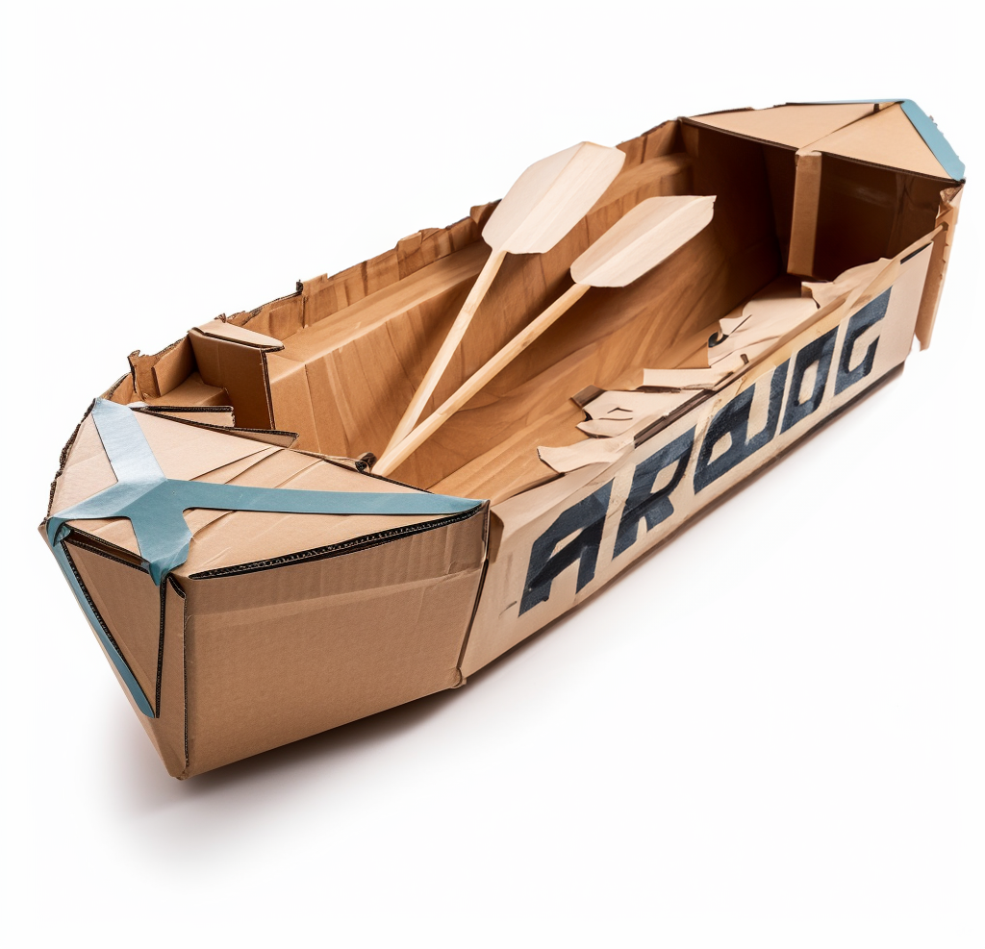
Clipper
Believe You Can Achieve The Impossible!
90min -
120 min
Players 8-
Unlimited
Live
Outdoor
The Clipper Classic is about believing you can do the impossible – build a boat out of cardboard that will race across the pool and carry two crew members across the finish line! As the navigating officer divides the group into crews, the provisions of cardboard and duct tape are shared, and orders are issued. There is visible consternation in the group. Everyone knows the task is impossible – cardboard doesn’t float!
Ideas fly. Conversations ensue. Attitudes change. Creativity abounds. The ships begin to take shape, doubts are dissipated, and a new spirit and courage take form within each of the teams. Your team fosters unity, unleashes creativity, and embraces risk-taking. Which teams will cross the finish line intact?
Intro
90 Minutes
Building
Competition
Awards

