Slide 1
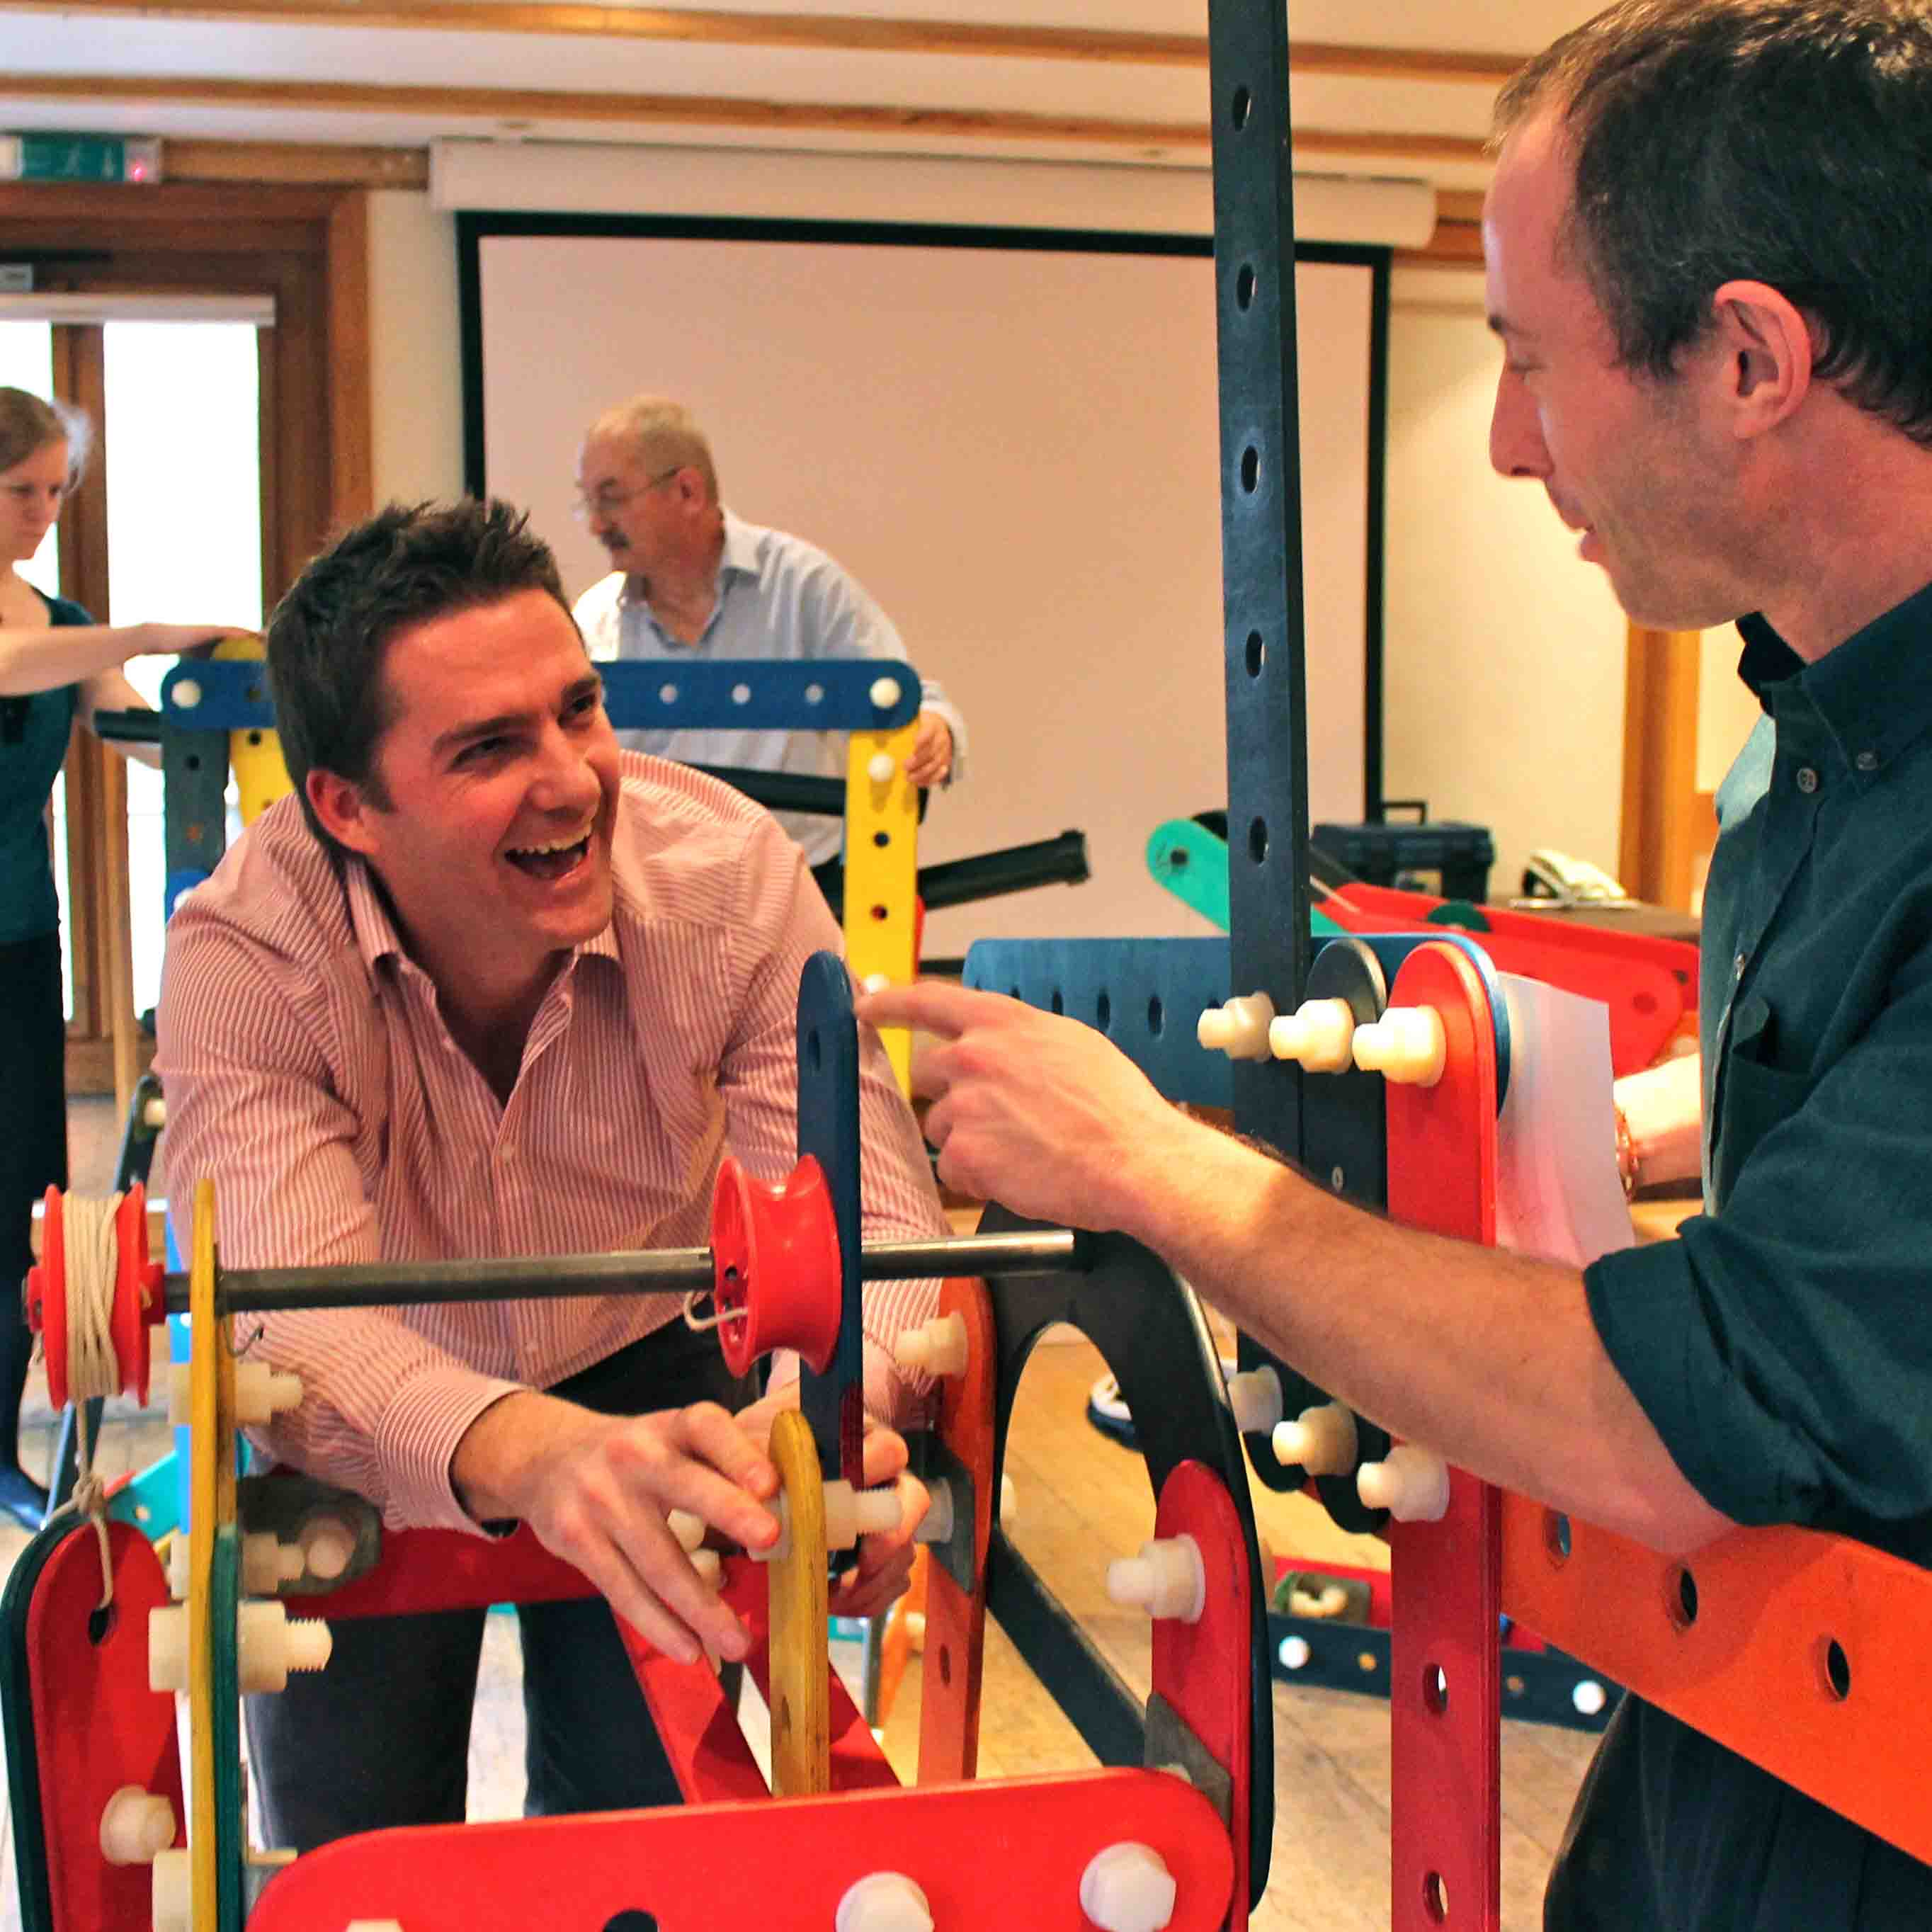
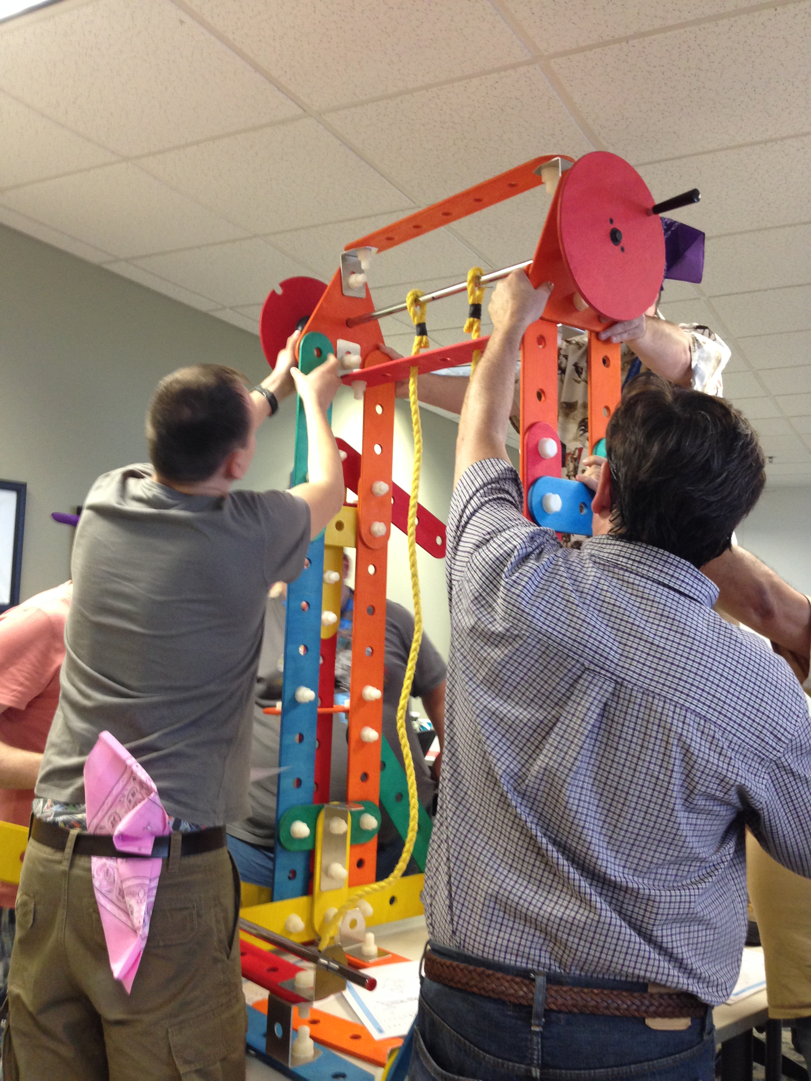
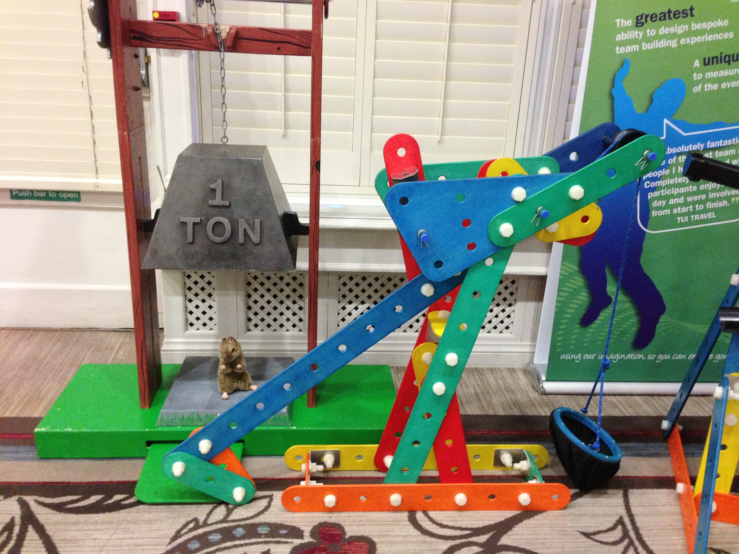
Rat Trap
Life-Sized Game of Mousetrap!
90 to
120 min
Players 9 -180
Live
Indoor
Outdoor
Experience the excitement of Rat Trap, the ultimate chain reaction challenge! Collaborate with your team to construct a series of contraptions that, when strategically positioned and triggered in the right sequence, set off an ingenious chain reaction leading to a thrilling finale. This engaging event not only unleashes your team's creativity but also hones problem-solving and teamwork skills.
With attention to detail and a touch of lateral thinking, Rat Trap showcases the incredible achievements that can be attained through effective collaboration. Don't miss out on the opportunity to immerse yourself in this captivating experience and witness the power of teamwork in action.
Intro
Strategy
90 Minutes
Build
Present

