Slide 1
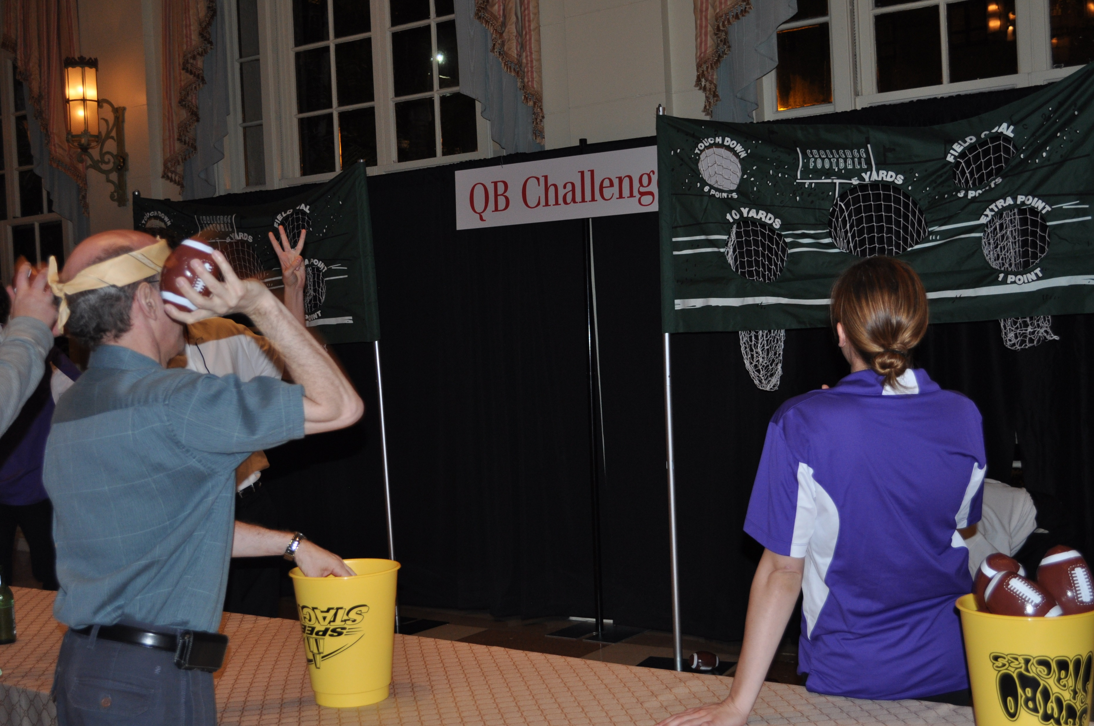
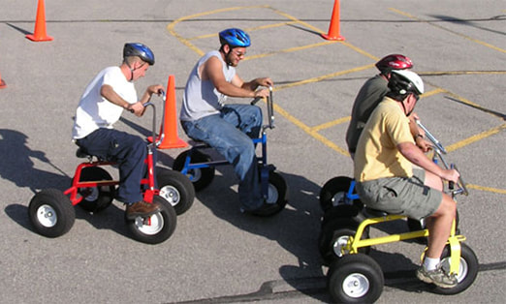
Your Way
PLAY! Any Way You Want!
60 to
120 min
Players 20 –
Unlimited
Live
Indoor
Outdoor
This fast paced event blends great networking opportunities with games of high competition, hit TV shows, frat house and tailgate parties! Compete in activities sure to test skills, nerves, wits and talents as you compete for the glory! Mind games, physical games, strategy games sporting games or just LOL games, there is a challenge for you. Jump in, earn points, have fun.
The event has a ‘carnival’ feel – you can play any game as many times as you want. Everyone is on a team for scoring, yet meets others to join in the challenges. Play hard, play often, play well and be the team with the highest score at the end. Play for victory and bragging rights, or translate this into the ultimate philanthropic give-back – donating cash to a charity!
Intro
60 Minutes
Challenges
Awards

