Slide 1
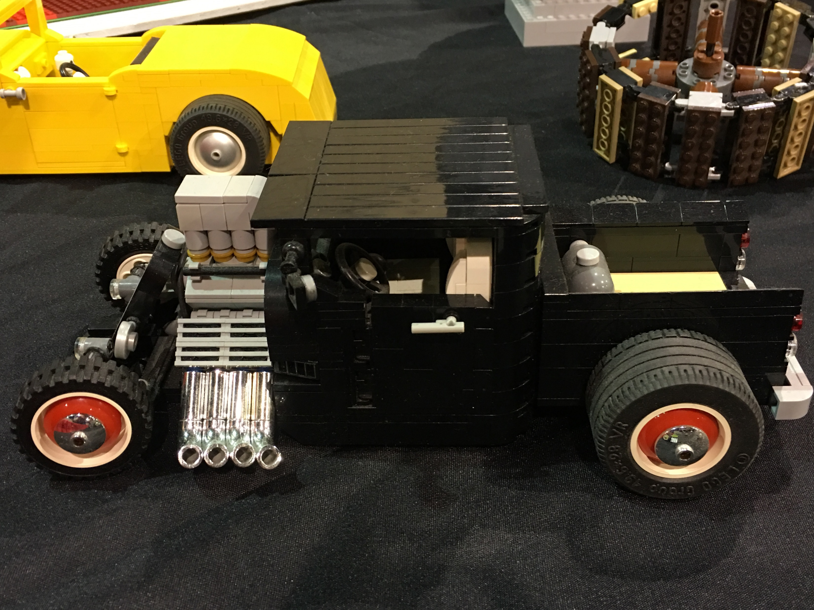
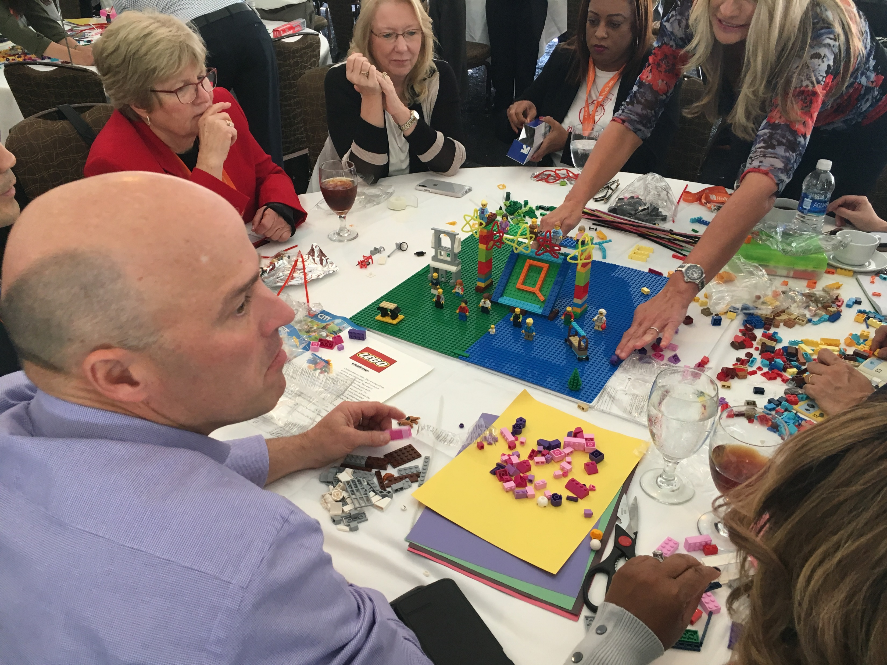
Challenge
“What Will YOU Make?”
60 to
120 min
Players 8 –
Unlimited
Virtual
Live
Indoor
Outdoor
Elevate your team's dynamics and boost creativity with our exhilarating Lego Fun shop! This unique teambuilding event brings together newcomers and veterans, inspiring them to collaborate, share ideas, and create something truly extraordinary. As your guests enter, they'll find themselves immersed in a world of imagination and armed with a diverse range of creative materials. From Legos and pipe cleaners to construction paper and foil, every resource fuels innovative problem-solving and sparks child-like wonder.
The objective? Design and construct a captivating tabletop structure that embodies the essence of collaboration. Through this hands-on, minds-on experience, participants will strengthen communication, forge meaningful relationships, and even uncover novel solutions to complex challenges. To add a touch of friendly competition, we can award prizes for the most remarkable designs. Don't miss out on this exhilarating opportunity to unleash the full potential of your team. Join us for the Lego Fun shop and embark on a thrilling adventure of creativity, unity, and endless possibilities!
Intro
90 Minutes
Challenge
Teams Present /Judging
Awards

