Slide 1
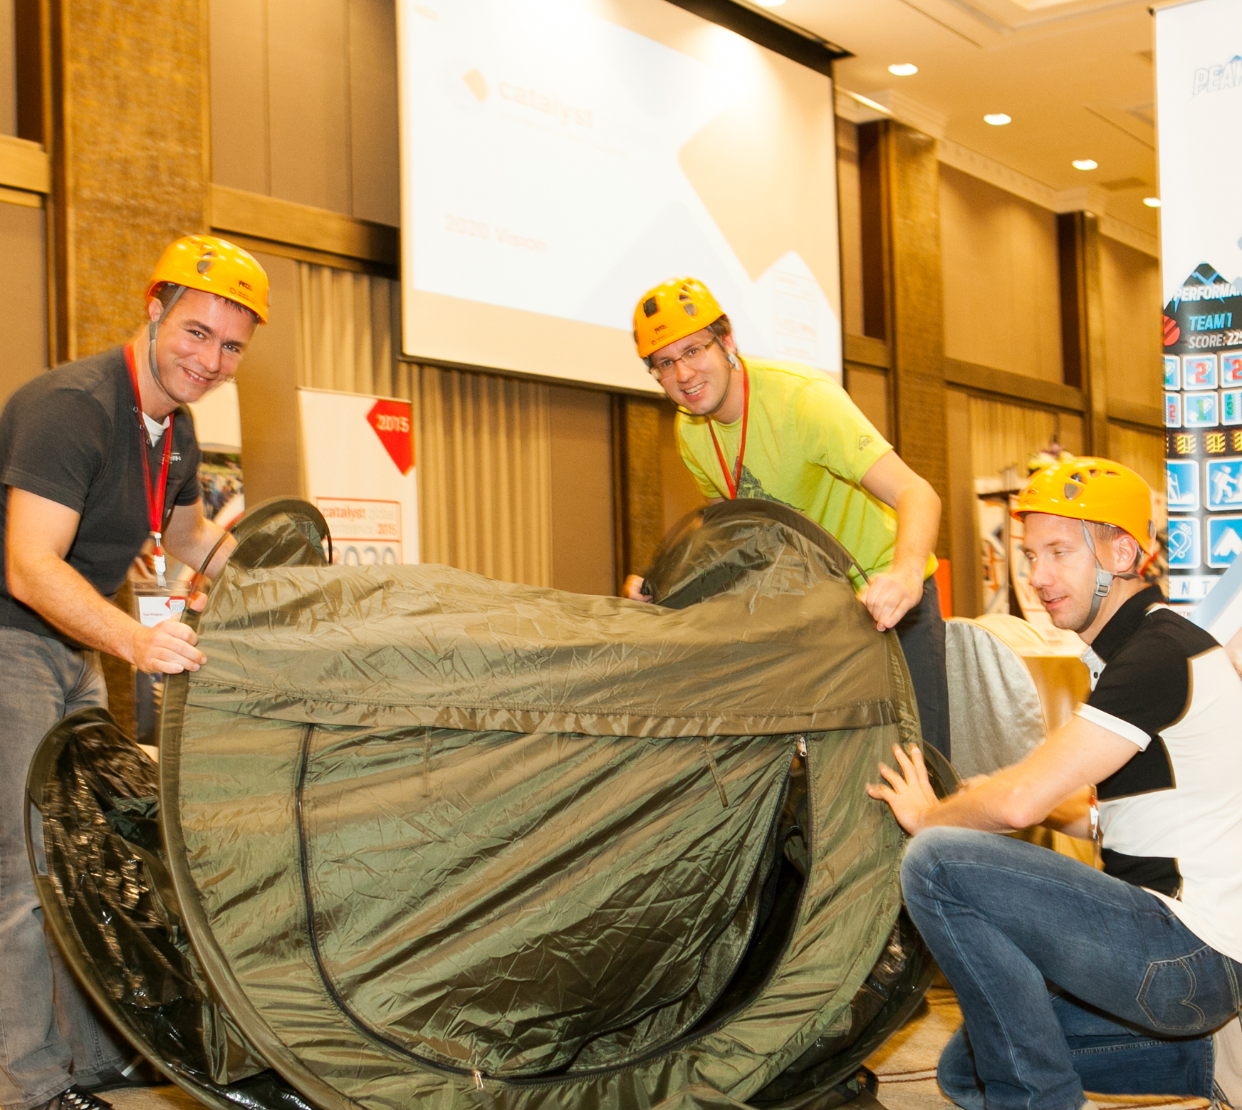
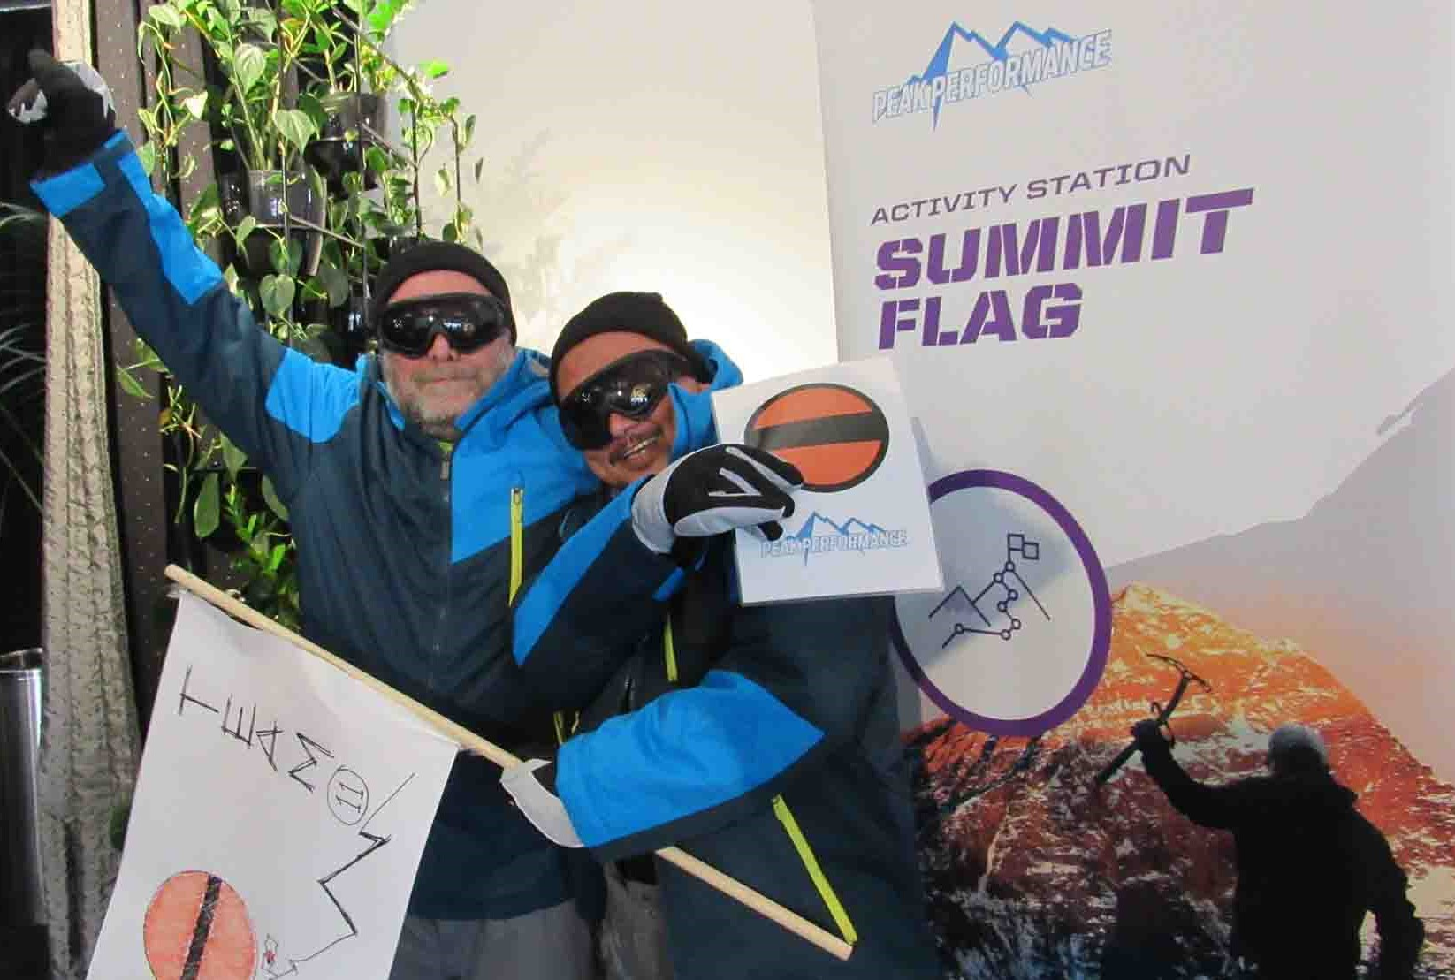
PEAK
Performance
Calling All Everest Expedition Leaders!
2.5 to 3
Hours
Players 10 -500
Virtual
Live
Indoor
Embark on one of the most challenging feats in human history – climbing Mount Everest. Everything is going as planned when the temperature suddenly drops to 10 below and blizzard conditions are on you in an instant. You and your team have a decision to make – do you continue to the next checkpoint and risk exposure or pitch your tents, ride it out and risk not making it to the summit at all.
Peak Performance is a Business Simulation Game designed to illustrate the challenges of making key business decisions. During this simulated 20-day challenge teams guide their clients to the top of Mount Everest and then safely back to base camp and just like in business, they must take into consideration all of the factors that will affect the mission in a constantly changing environment.
Along the way, encounter a series of active challenges including pop-up tent pack ups and a blindfold climbing harness challenge. Peak Performance is an exciting, immersive way of improving critical thinking and decision making in the workplace.
Intro
Icebreaker
Strategy Stage
120 Minutes
Climbing Mt.
Everest
Awards

