Slide 1
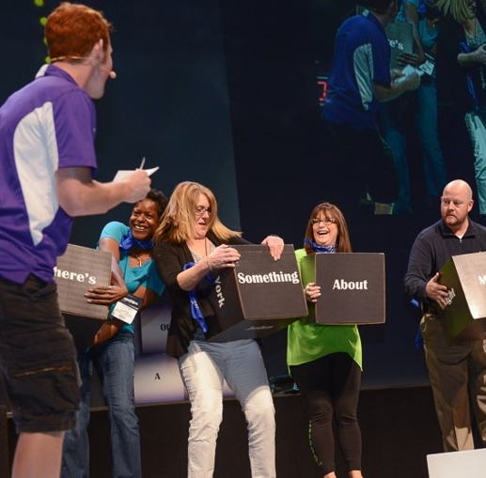
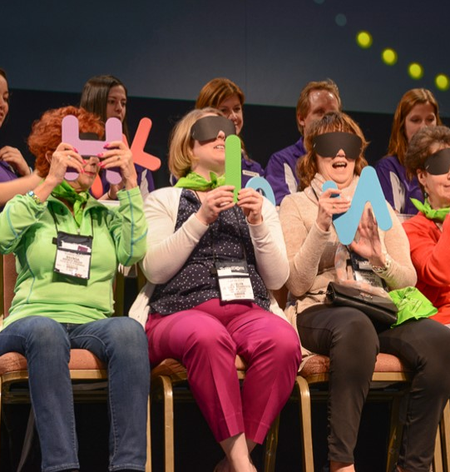
As Seen on
"Lights, Camera, Game On!"
60 to
120 min
Players 10 -Unlimited
Virtual
Live
Hybrid
Indoor
Outdoor
Experience an electrifying and unforgettable event with our "As Seen On TV" game show! Featuring thrilling challenges inspired by iconic TV shows, this engaging experience will keep energy levels soaring and ensure maximum participation from your entire group. Whether you choose it as a standalone event or during a meal, our flexible options allow for a tailored experience that aligns with your conference's objectives and goals.
Contestants will be selected in fun and random ways, adding an extra layer of excitement, and complete customization is provided to suit your event's unique requirements. With guaranteed laughter, joy, and unforgettable moments, our game show will leave your guests buzzing with excitement as they create lasting memories and forge connections with their colleagues. Don't miss out on this opportunity to make history together and create a legendary experience that will be talked about for years to come!
Intro
90 Minutes
Activity
Awards

