Slide 1
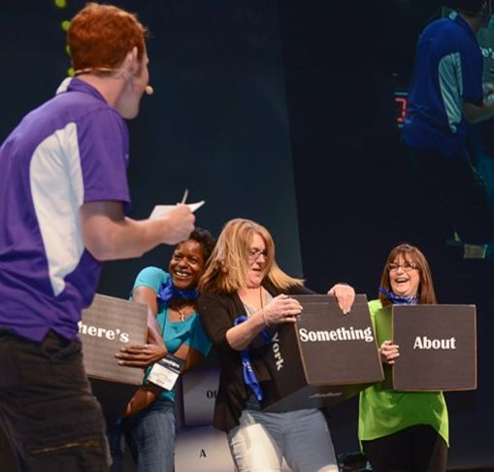
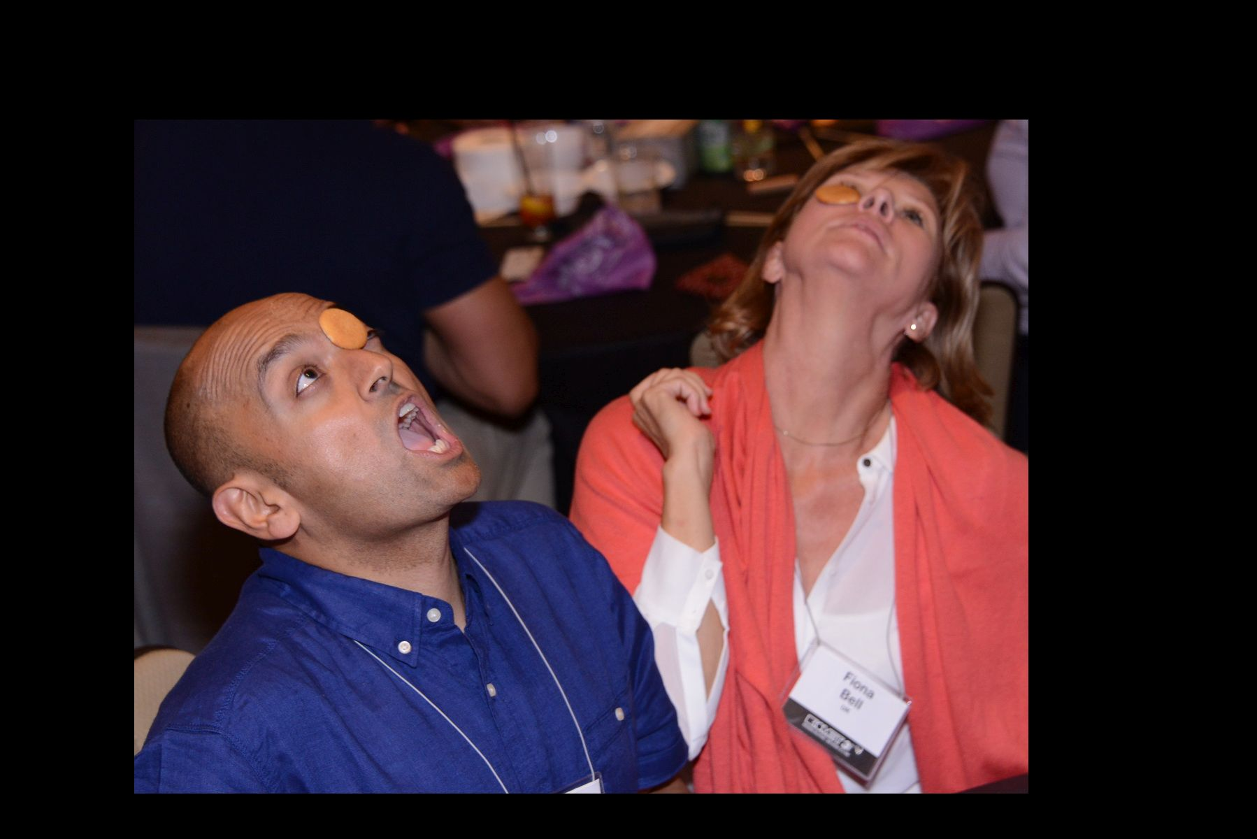
Calling All Game Show Lovers!
60 to
90 min
Players 10-
Unlimited
Virtual
Live
Indoor
Outdoor
Experience the ultimate in excitement and engagement with FARRAGO LIVE! FARRAGO literally means hodge-podge, and that’s what this one-of-a-kind game show delivers! It keeps your attendees on the edge of their seats as EVERYONE becomes a contestant, creating an electrifying atmosphere from start to finish. With a dynamic Game Show Host, spirited contests, and a variety of thrilling challenges, FARRAGO LIVE guarantees a non-stop adventure that will leave your guests laughing and bonding with their colleagues like never before. Whether you choose it as a standalone event or during a meal, our customizable games can be tailored to fit your specific conference objectives, location, time frame, and team goals. By sponsoring the "FARRAGO" game show, you'll make history and create a night that will be remembered for years to come. Don't miss this opportunity to elevate your event and provide an unforgettable experience that will have everyone talking!
Intro
Game 1
Game 2
90 Minutes
Game 3
Game 4
Awards

